Slide 1
Who wants to go Camping during Covid 19?
Allen Virtusio, Carmela Monis, Julius Castro, Linda Stark, Tina Ren

Slide 2


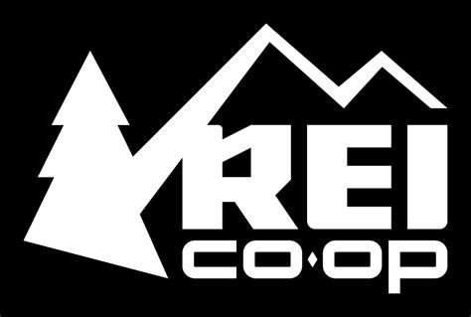



Hypothesis
Did Covid-19 have a significant growth impact on camping gear while hurting other retail categories?

Slide 3
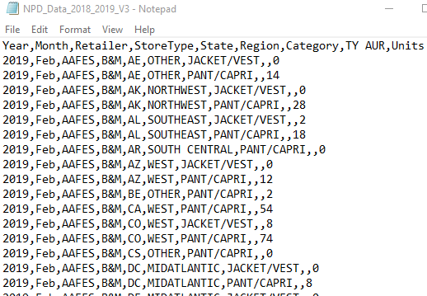
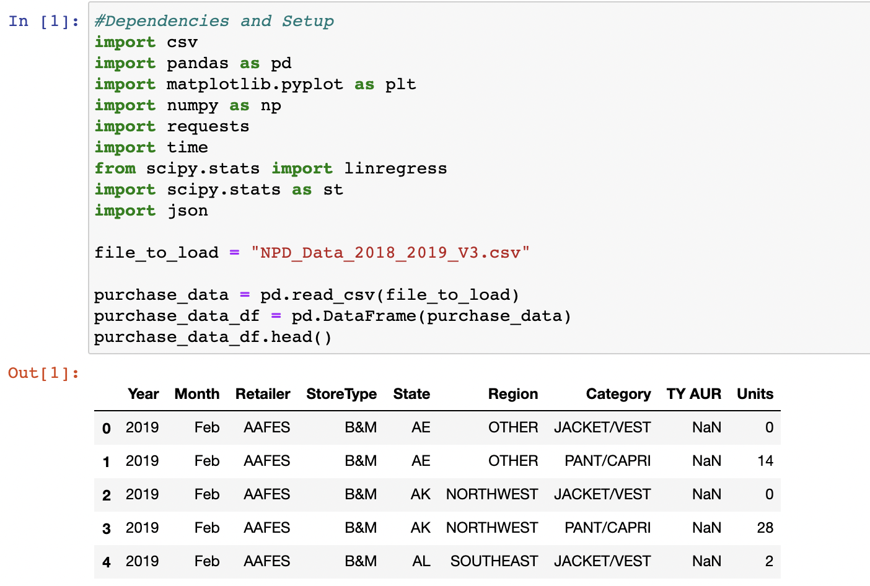
Parameters
RETAILERS: DSG, BACKCOUNTRY, REI, HIBBETT, MOOSEJAW, MACY’S, NORDSTROM’S, ZAPPOS.COM, ACADEMY, DILLARDS…
TIME FRAME : NATIONAL RETAIL FEDERATION CALENDAR YEARS 2019 – 2020 (FEB – JAN)
STORE TYPES : BRICK AND MORTAR, ECOMMERCE, OUTLET
APPAREL
PANTS, CAPRI, JACKETS and VESTS
CAMPING GEAR
TENTS AND SLEEPING BAGS
OTHER
BACKPACKS
Data Source : https://www.npd.com/wps/portal/npd/us/news/insights/

Slide 4
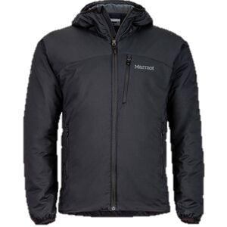
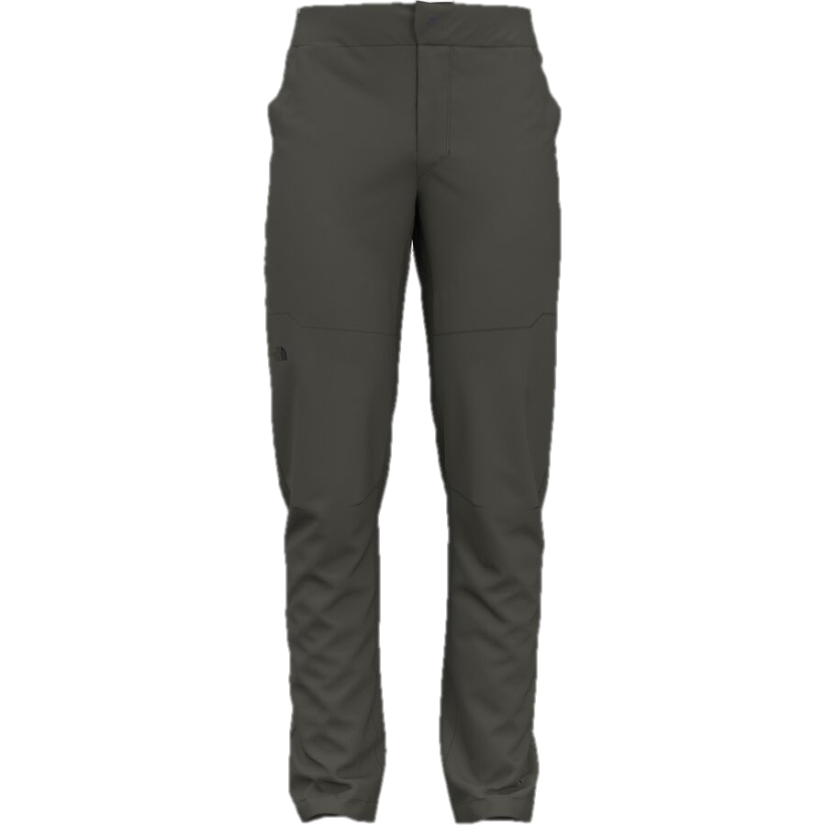
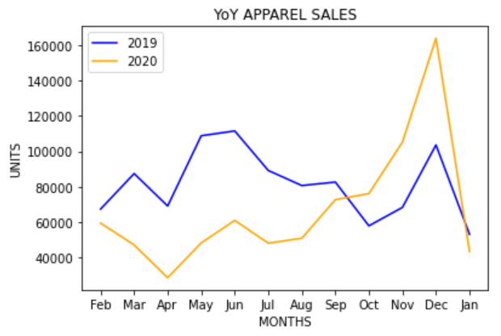
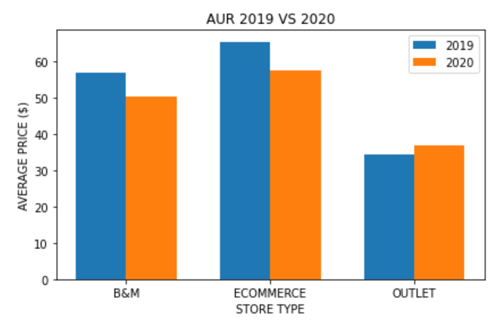
APPAREL
Findings:
Apparel categories declined in 2020 vs 2019.
Biggest dip was in March and April as stores closed.
Average Unit Retail throughout 2020 was below the average in 2019 – more discounts.
There was an uptick in Apparel sales in October and November as retailers were heavily discounted for the holidays.
JACKETS, VESTS, PANTS and CAPRIS

Slide 5
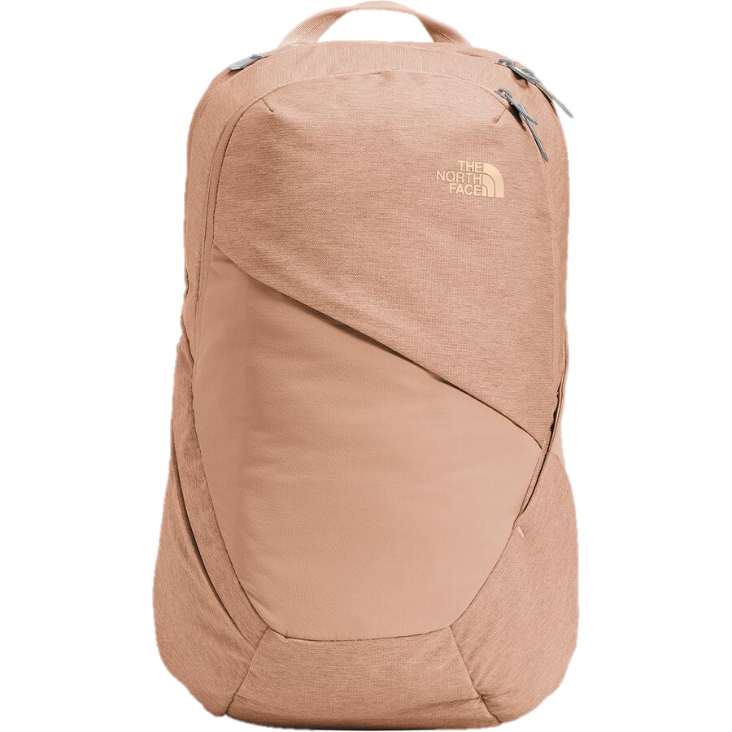
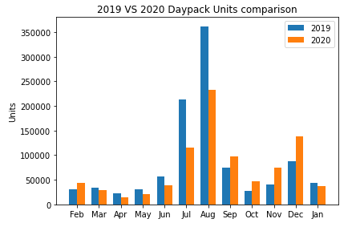
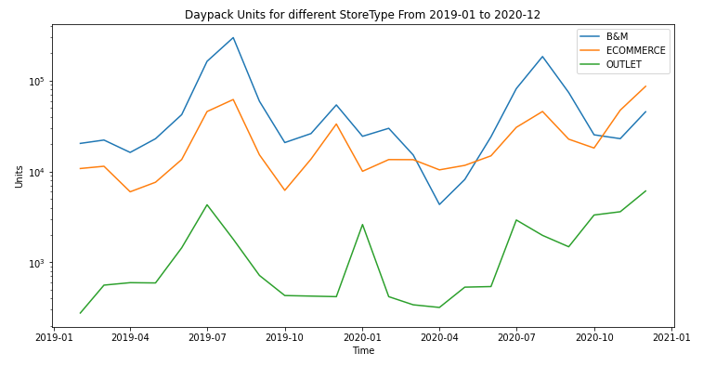
DAYPACKS
Findings:
Daypack sales increased after covid summer vacation.
Due to school closures – June/July/Aug sales were very soft.
Covid summer vacation is a watershed.
The outperforming trend keeps until Christmas.
Covid made Ecommerce out performs B&M.
B&M & Ecommerce have similar trends.
At 2020/April when it locked down, Ecommerce out performs B&M even at a seasonal dip.
BACKPACKS

Slide 6
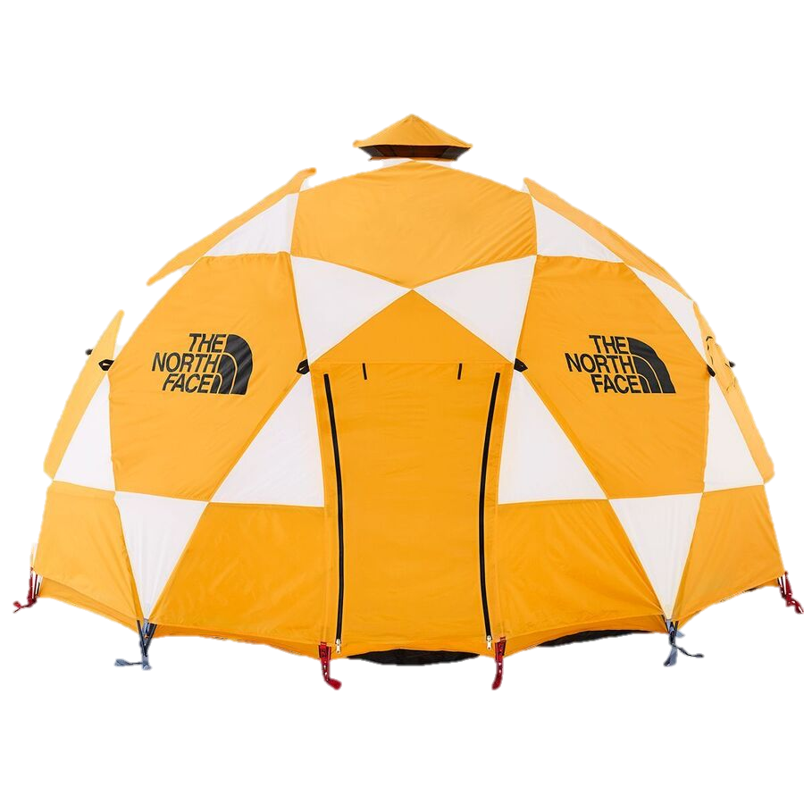
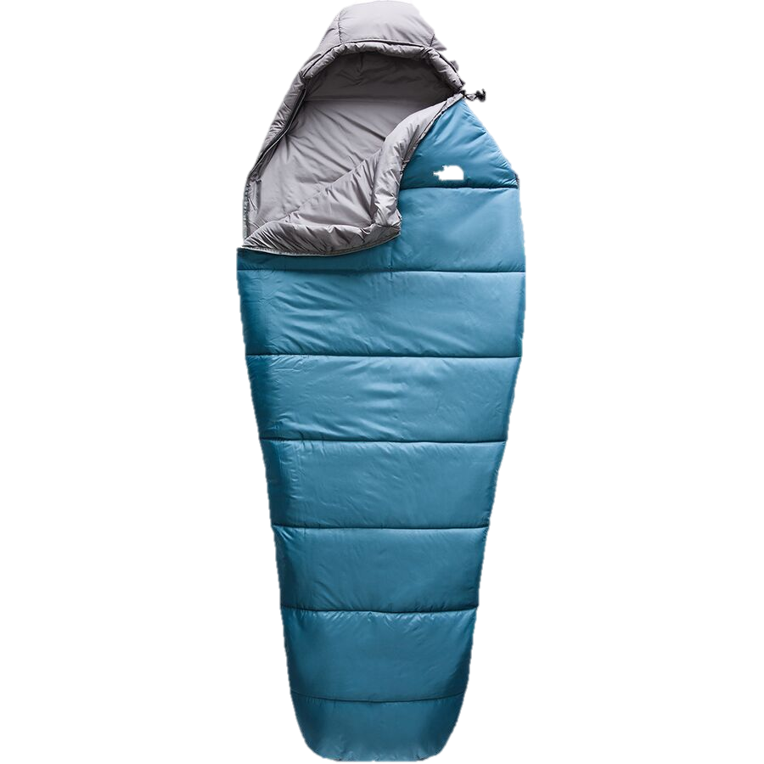
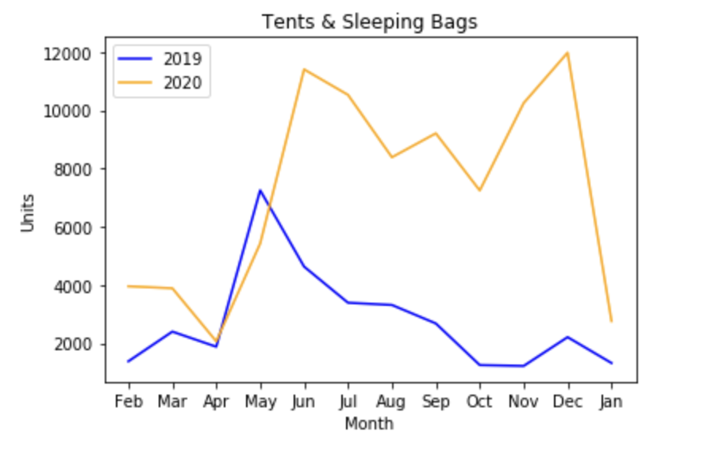
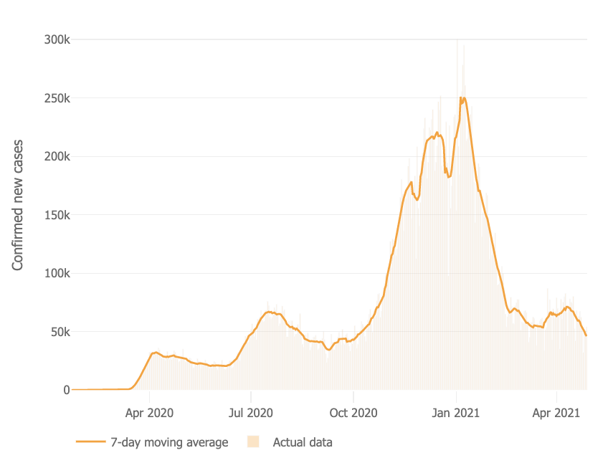
CAMPING
Findings :
A large gap of the units sold in 19 vs 20 starting in April.
April, after shut downs occurred – Only camping and outdoor was an option for recreation.
Saw a large spike in October as third wave hit the US.
TENTS and SLEEPING
*https://coronavirus.jhu.edu/data/new-cases

Slide 7
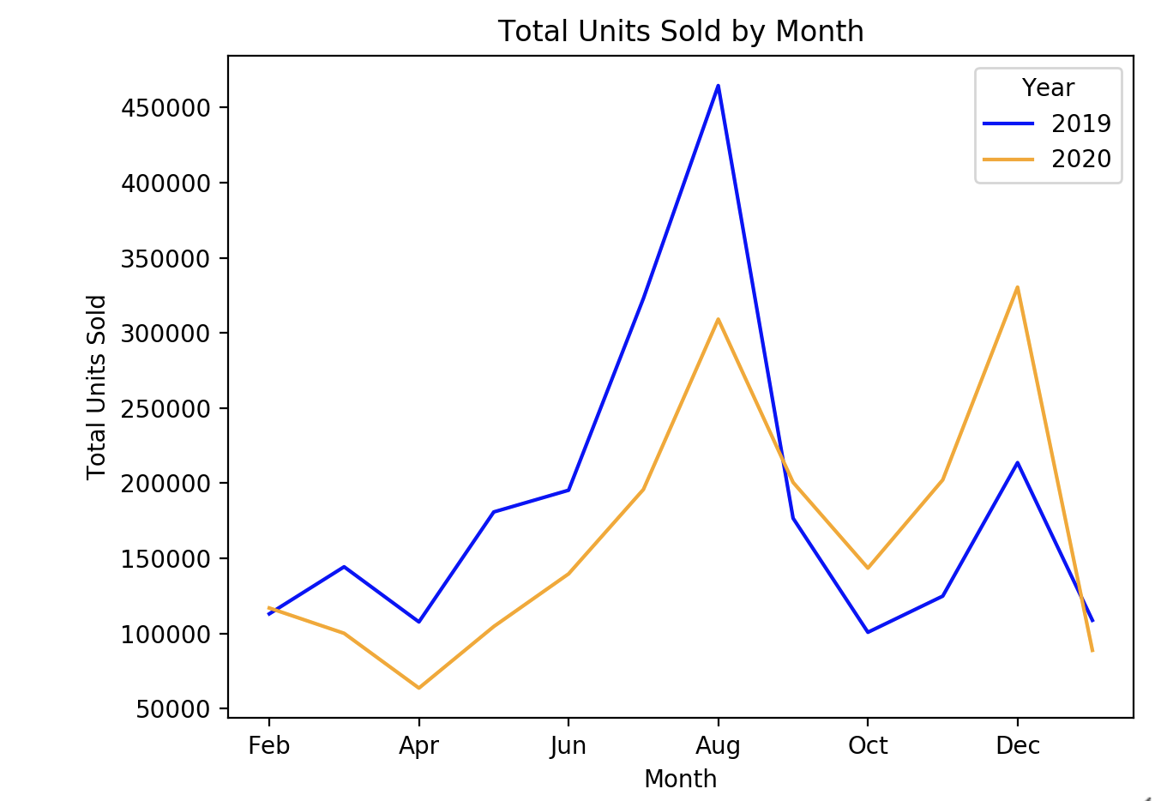
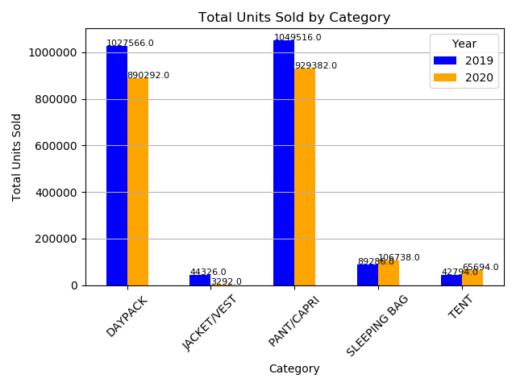
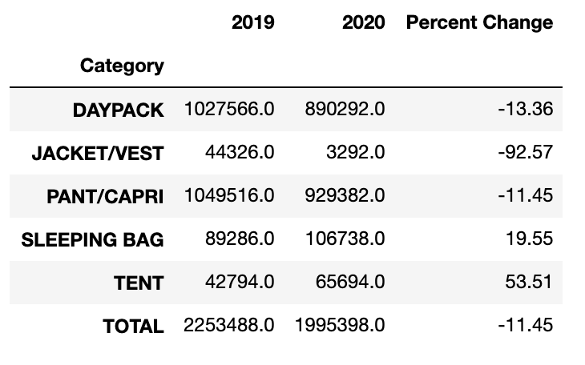
TOTAL
Similar pattern through both years.
Outdoor retailers had a decline of almost 12% in the units they sold in 2020 compared to 2019.
Only saw an increase in camping equipment such as tents and sleeping bags.

Slide 8
POST MORTEM
What we would do differently.
LIMITATIONS
Would have pulled in more camping equipment categories – grills, kayaks, coolers…
Could have looked at other apparel items
Could have looked at National Parks attendance and camp site reservations.
Could have used more years than just 2019 and 2020 to get a broader picture.
Could have done a survey.

